Slide 1


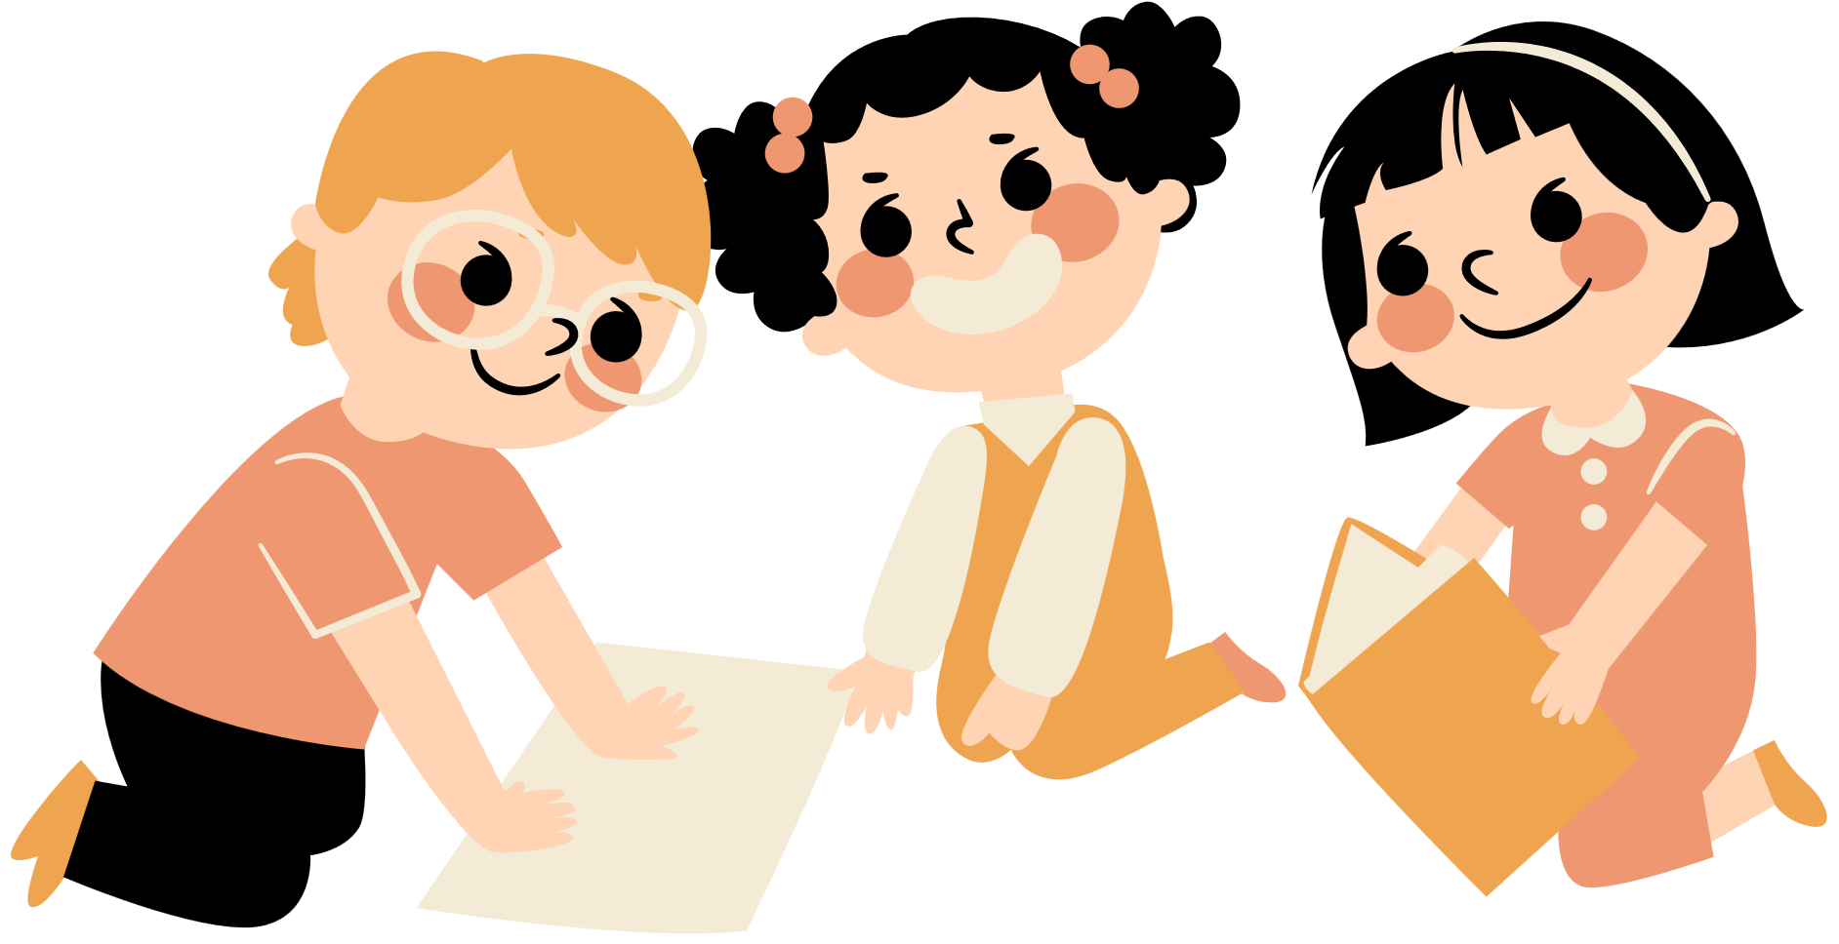
Unit 11
There’s a doll on the rug.
Lesson 2

Slide 2
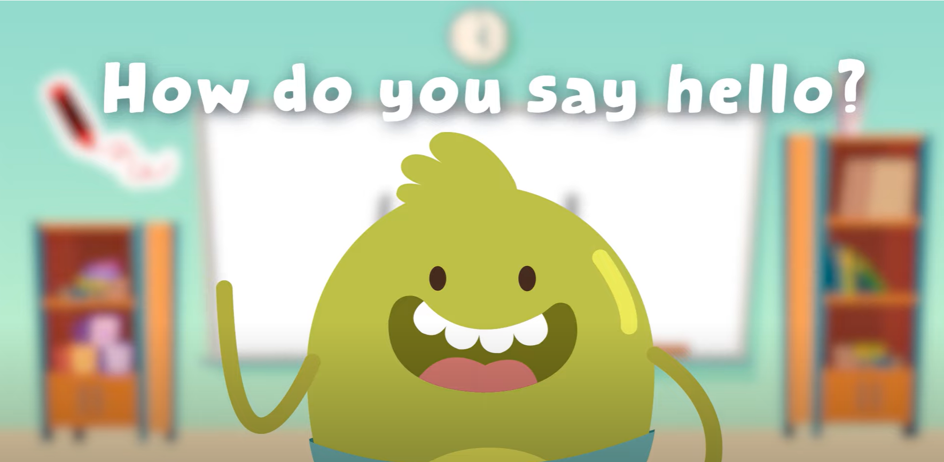
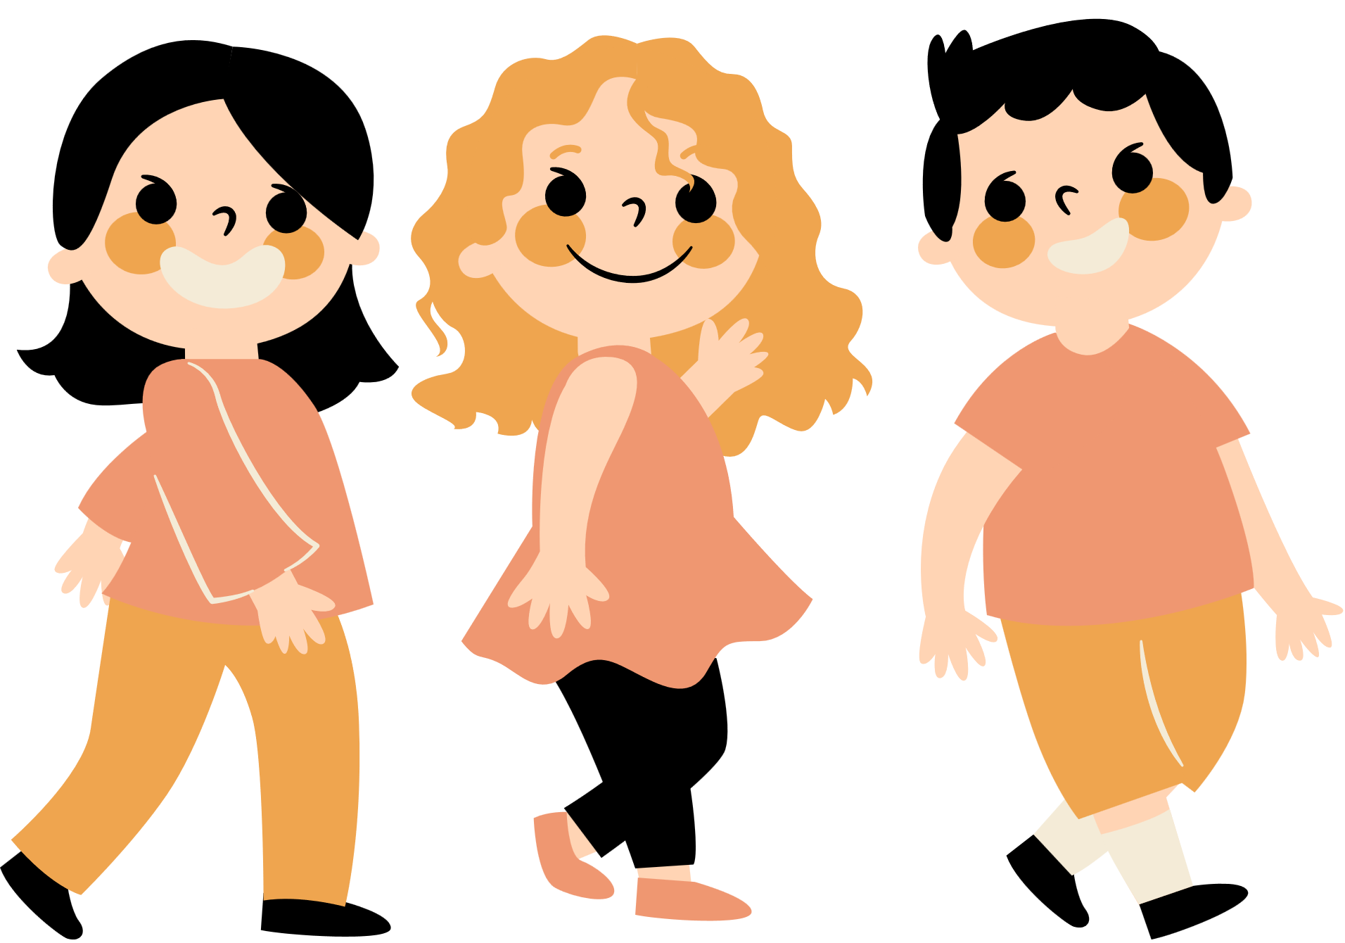
Hello song

Slide 3


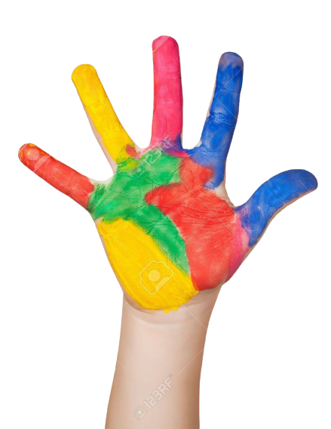



Give me Five

Slide 4

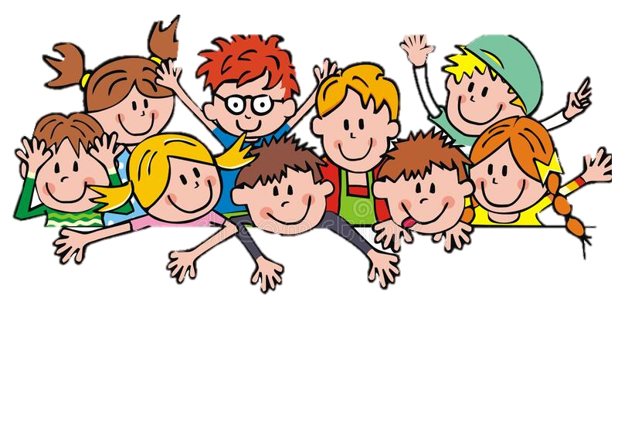
Game

Slide 5
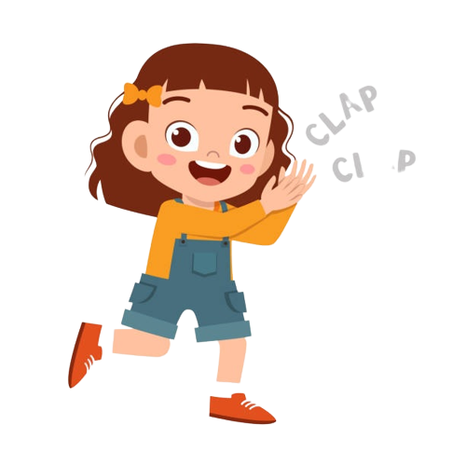
Good job!

Slide 6



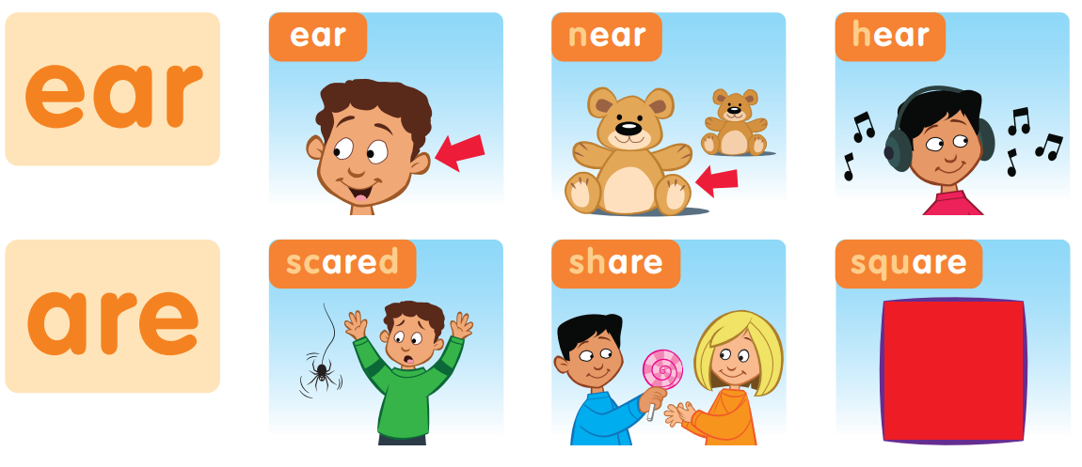
Listen and Point

Slide 7
Listen and Repeat

Slide 8
Good job!

Slide 9
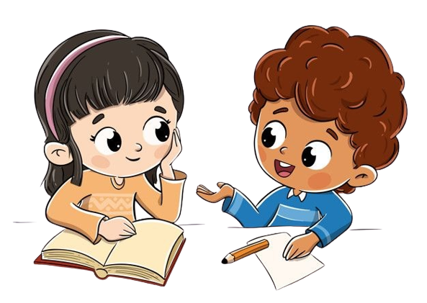

Work in groups
Point and Say

Slide 10
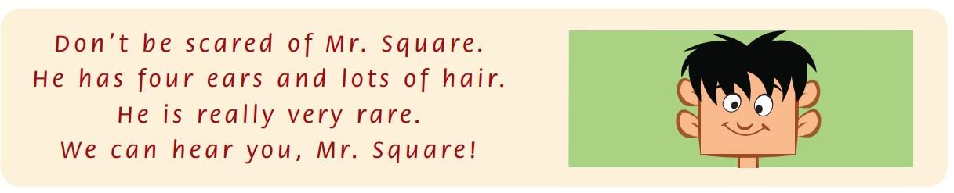
Listen and Point

Slide 11
Listen and Repeat

Slide 12
Listen and Chant

Slide 13
Good job!

Slide 14
Work in groups
Point and Say
Notes:
Read the chant again. Say the words with ear and are.

Slide 15
Good job!

Slide 16
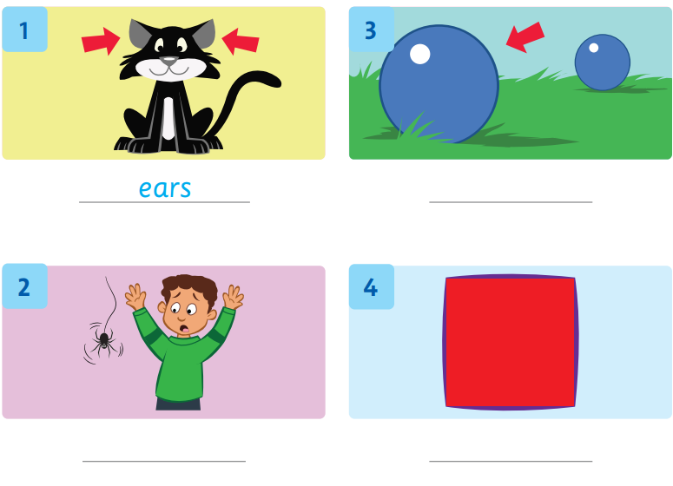
Look, Write and Say
near
scare
square

Slide 17
Good job!

Slide 18
Game

Slide 19
Good job!

Slide 20
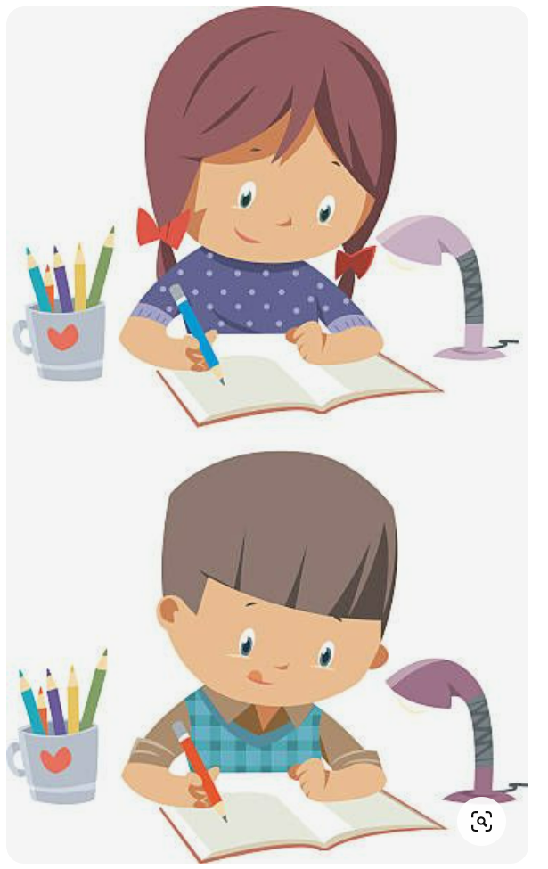
Homework

Slide 21

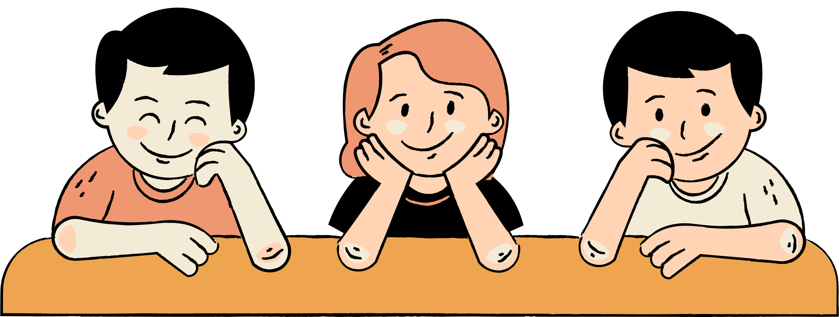
Thank You

